Slide 1

A Mini Project Report
on
COOL CAB BOOKING SYSTEM
by
Akshay Neurgaonkar (T223037)
Tejas Inamdar (T223020)
Ravikant Rathod (T223048)
Under the guidance of
Prof. Aniruddha Kshirsagar
Department of Computer Engineering
ZEAL College of Engineering and Research, SAVITRIBAI PHULE PUNE UNIVERSITY
2020-2021

Slide 2
Table of Contain:
Introduction:
Literature Review:
Objective:
Flowchart/ Usecase Dig./ Dig.
Methodology (Which algo. / method / technique use in our system)
Software & Hardware Specification
Result
Advantages:
Disadvantages:
Application:
Conclusion:
References:

Slide 3
Introduction
* Cab Booking System specializing in Hiring cabs to customers. It is a system
through which customers can view available cabs; register the cabs, view profile and book
cabs.Cab booking service is a major transport service provided by the various transport
operators in a particular city. Mostly peoples use cab service for their daily transportations
need. The company must be a registered and fulfils all the requirements and security
standards set by the transport department.
* A Cab Booking/Hiring is a system that can be used temporarily for a period of time with a
fee. Hiring a car assists people to get around even when they do not have access to their
own personal vehicle or don't own a vehicle at all. The individual who want to hire/rent a
car must first contact the cab hiring company for the desire vehicle. This can be done
online. At this point, this person has to supply some information such as: dates of rental,
and type of car. After these details are worked out, the individual renting the car must

Slide 4
Literature Review
Actual cities are oversaturated, on one hand most of the population is concentrated in large
cities (in 2030 more than 80% (UNFPA 2007) of the population will live in urban areas),
on the other hand mobility needs of the modern population are growing continuously.
While urban demand for trips is growing constantly, supply (capacity of city streets) is
limited, and must be optimized, not increased (most of the times not possible inside the
city). Well-planned, efficiently operated, and cost-effective transportation system
management (TSM) strategies can improve mobility of existing systems for transportation
users, especially in urban environments, where a good optimization of the infrastructure is
needed (considering the high cost of building new facilities and the continuously
increasing demand resulting from economical and population growth). Last years
tendencies are shifting person trips from private vehicles to public vehicles, increasing the
Public Transport share importantly. The most used Public Transports are the “Mass
Transports” such as metro, tram or bus. This kind of transport usually has a centralized
management which uses ITS technologies developed in the last decade for an optimal
operation of the service.

Slide 5
Unfortunately, inflexibility, long total travel time and insufficient service coverage of
Mass Transport systems cause a lower usage of them in most metropolitan areas.
Oppositely, the taxi-cab sector is a more convenient mode due to its speediness, door-todoor
attribute, privacy, comfort, long-time operation and lack of parking fees. The great
Josep Maria Salanova et al. / Procedia Social and Behavioral Sciences 20 (2011) 150–161
151 inconvenience is the lack of central management; each taxi is operated by an
independent driver, taking his own decisions continuously, with a weak intent of control by
the policy issues of each city such as license control or distributing the working days of the
taxi vehicles (normally the control is imposed on vehicles, not on drivers, generating
double shift and increasing the use of taxis). An important percentage of the cars (e. g.
60% in Hong Kong (Yang et al. 2000)) in the daily flow are taxis, most of them empty
taxies. This situation is creating two problems, an internal problem to the taxi drivers
(higher empty kilometers means lower benefits) and an external problem to the citizens
(congestion and pollution). The first problem is being aggravated with the actual economic
crisis, which is breaking the market equilibrium: demand is decreasing due to the lower
incomes of the population and offer is increasing due to the increasing number of taxi
drivers (not taxi licenses). Market equilibrium cannot be achieved in this concrete market
because of the regulations (price is not established freely), and cannot go to the next
equilibrium point due to the price policies imposed in each city. This is a vicious cycle,
where empty hours are increasing, and taxi drivers need to work more time in order to have
the same income, which means lower income per hour (Daniel (2006)). In this situation,
taxi drivers prefer to stop at taxi stands and wait for a client, without expending fuel in
empty trips and consequently saturating the taxi stands. If taxi stops network is not well
designed, this situation will create a decrease in the Level of Service of the passengers,
decreasing the demand and congesting the streets near the taxi stops.

Slide 6
Objective
¬ To keep the information of Customer.
¬ To keep the information of number of bookings.
¬ To keep the detail of taxis route.
¬ To keep the information of cancellation and modification of booking.
¬ To maintain the record of every employee of every route.

Slide 7
Flowchart / Usecase dig. / dig.

Slide 9
User : Use case diagram

Slide 10
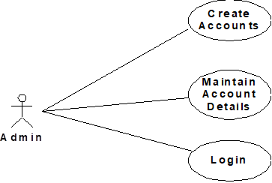
Admin : Use case diagram

Slide 11
Methodology (method / technique)
Programming lang. : Python3 is used for the programming of the application & for all functionality and backend to gui.
Tkinter library: it is used for frontend and gui of the projects. From that library the listboxes,frames,dropboxes,entries,buttons etc. like and many other functionalities are imported & used.
Sqlite3 database : It is used for the database. Which you need to download first from the pyorganisations/. Using this sqlite3 database data is stored in the tabular format.
DB browser: It is used for the monitoring of the data at the time of login and other time too.

Slide 12
Software & Hardware Specification
Software Specifications :
Front End: Tkinter
Back End: Python, Sqlite3
Operating System: Windows 7/8/10
Runtime Framework: Microsoft .NET Framework

Slide 13
Hardware Specifications :
Processor: Intel/AMD/ARM Processor, 1Gz or better (Minimum)
RAM: 2GB (Minimum)
HDD: 160 GB, 7200k spin (Minimum)
Core: Dual core (Minimum)

Slide 14
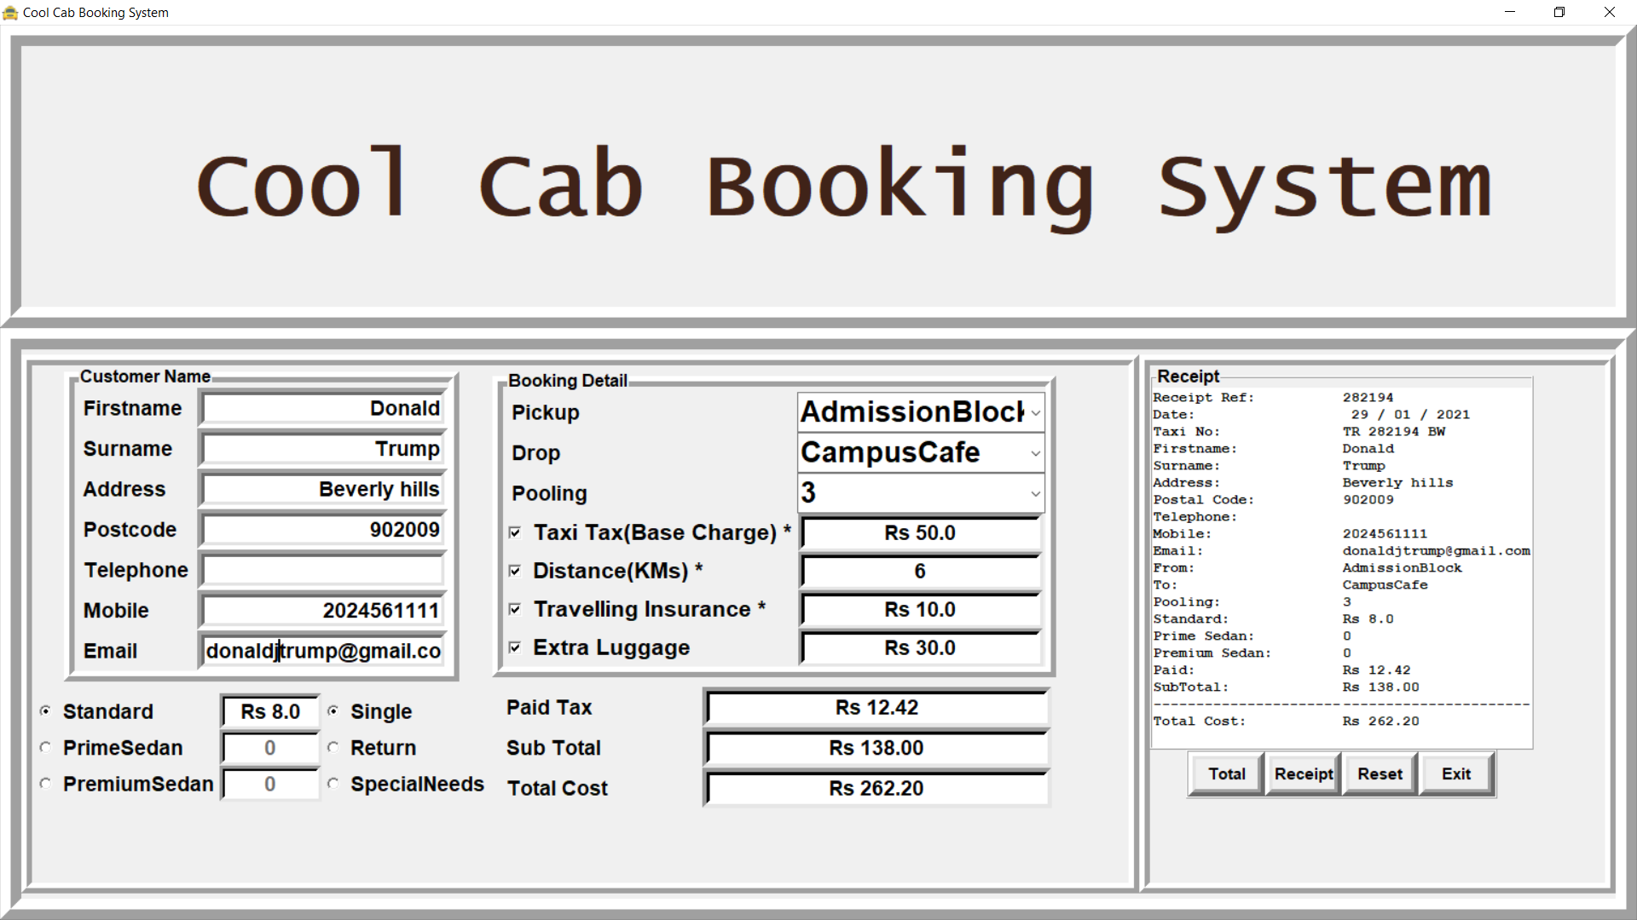
Result

Slide 15
Advantages
A route-based booking system that facilitates the issue of journey-cum-booking cab, which can be issued from any station to any station.
Passenger journey to multiple laps of booking can be handled from a single terminal window.
The booking facility is offered round-the-clock (24 hours uninterrupted).
Changes in cab profiles (cab addition, replacement, de-allocation), route structures, etc., can be made effective immediately with the appropriate contingency handling.
Dynamic definition of the advance booking period is possible. This feature facilitates defining different advance booking periods for different cabs.
Any cab running schedule can be accommodated.
Provides aggregation of EIS figures such as revenue, cab utilisation, etc, and presentation of the summarised data in the form of visual analytics from the operational system's information store. The data aggregation is done incrementally, to inflict minimal impact.
Provides automatic database recovery against all kinds of hardware and software failures.
Complete audit trails for transactions and data access.
The application software is parametric, and standard cab business rules are incorporated in the form of data instead of being part of the logic.

Slide 16
Disadvantages
Cool Cab Services is a python application and it is restricted to only limited type of users.
In this application, Different types of managers have been given access rights…
They are restricted up to their functionalities, so that the data is maintained securely and redundant data is prevented.
As the Data is stored electronically, it is necessary to have a Computer and Network connection to access the Application.
Here The Details of Employees and Drivers, cabs are maintained but accounts to these people are not created.
using this application manger do assign or update the batch, cabs to drivers and employees.
But employees are unable to view their details.

Slide 17
Application
One can easily plan the journey comfortably as the process is efficient and fast with being easy to access.
Bookings can be made through the cab booking app through PC.
A route-based booking system that facilitates the issue of journey-cumbooking cab, which can be issued from any station to any station.
Passenger journey to multiple laps of booking can be handled from a single terminal window.
Changes in cab profiles (cab addition, replacement, de-allocation), route structures, etc., can be made effective immediately with the appropriate contingency handling.
Dynamic definition of the advance booking period is possible. This feature facilitates defining different advance booking periods for different cabs.
Any cab running schedule can be accommodated. Provides aggregation of EIS figures such as revenue,cabutilization, etc., and presentation of the summarized data in the form of visual analytics
The data aggregation is done incrementally, to inflict minimal impact.
Provides automatic database recovery against all kinds of hardware and software failures.

Slide 18
Conclusion
Information Technology plays a vital role not only in a particular field, it provides various
kinds of solutions and services to the various problems prevailing in many fields.
Cabs exploits information technology at the maximum extent. It uses the information
technology in an efficient way for providing better passenger services. The online booking
system helps to solve the everyday problems of the world biggest Indian

Slide 19
References
1. https://developers.google.com/places/web-service/autocomplete
2. https://developers.google.com/places/
3. https://books.google.co.in/.
4. https://designcode.io/
5. https://www.raywenderlich.com/
6. http://www.appcoda.com/
7. https://www.lynda.com/
8. www.google.com
9. https://pythonbasics.org/tkinter-listbox/
10. http://pythonbasics.org/
11. https://www.python.org/downloads/release/python-350/
12. https://youtu.be/usWosm3tPZQ

